Slide 1
The Next Recession?
New Canaan Rotary Club, January 31, 2019

Slide 2
12 Recessions since 1945.
Peak to Bottom: 11 months.

Slide 3
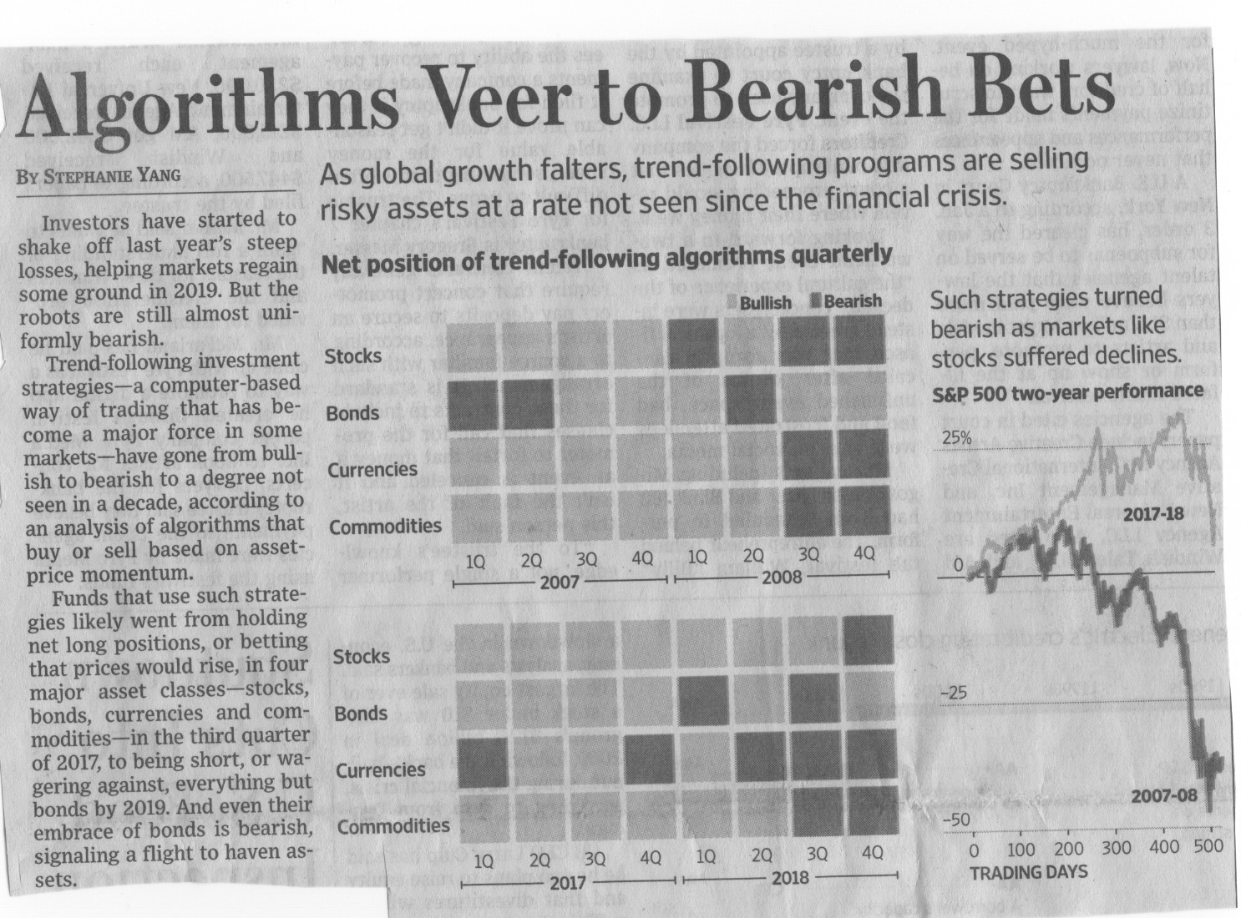
Wall Street Journal, January 10, 2019, B1

Slide 4
Computer Algorithms Anticipate Recession
Time Since Last Recession: 12 Months.

Slide 5
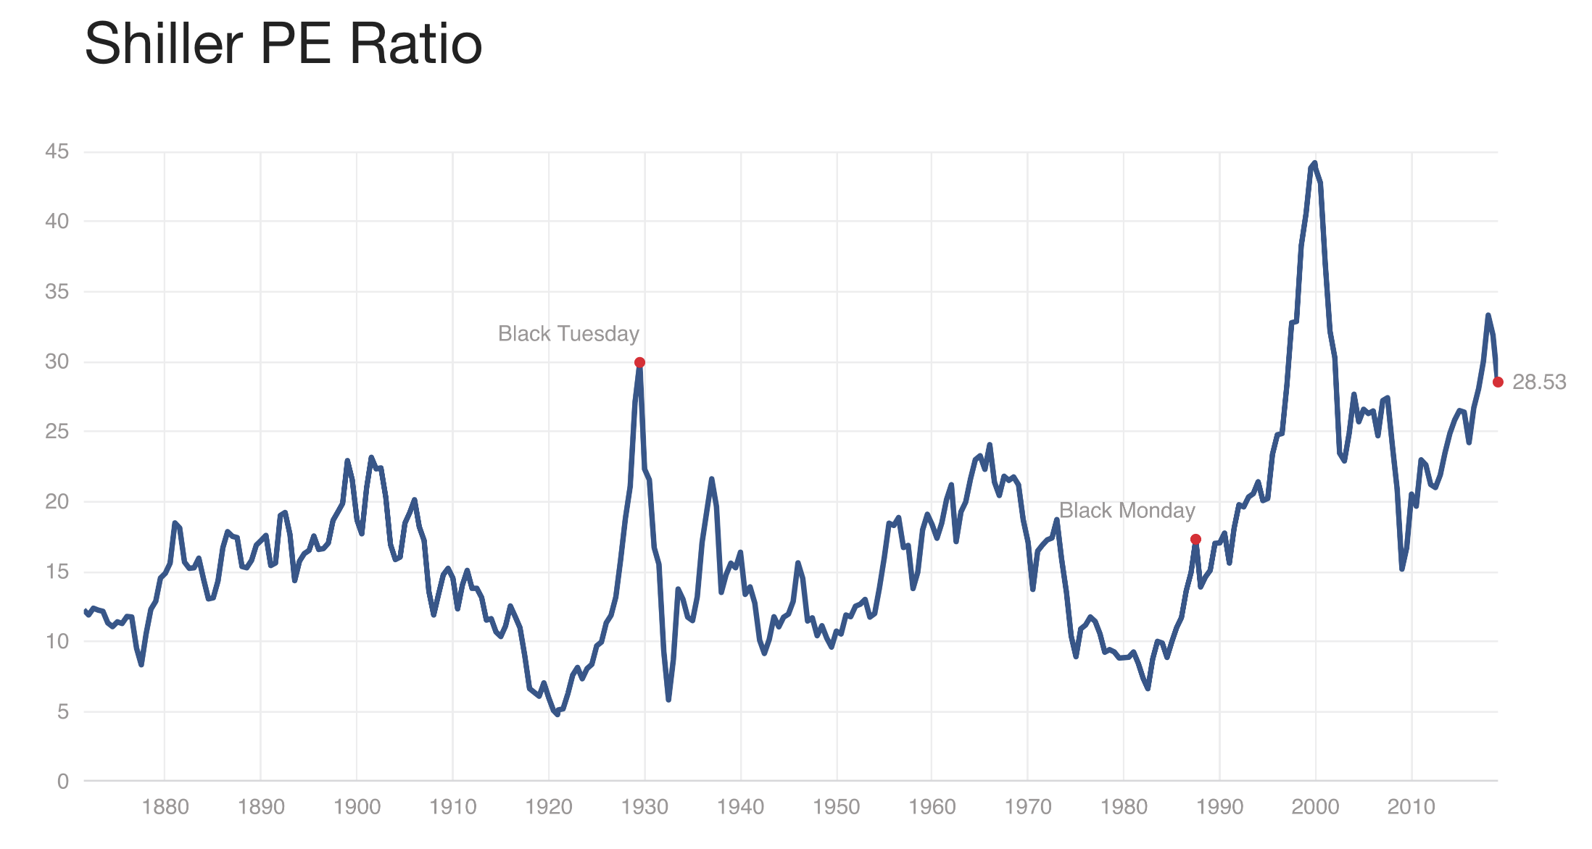
Yale University, January 11, 2019

Slide 6
Recession Indicator Close to 1929 P/E

Slide 7
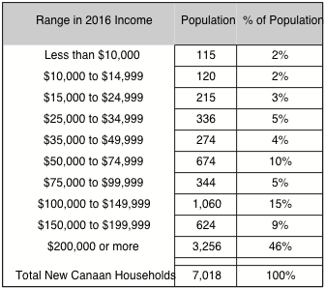
Small Recession Effects on New Canaan
https://factfinder.census.gov/faces/nav/jsf/pages/community_facts.xhtml
https://factfinder.census.gov/faces/nav/jsf/pages/community_facts.xhtml

Slide 8
Recession and New Canaan Households
Half of NC Households Have Safeguards

Slide 9
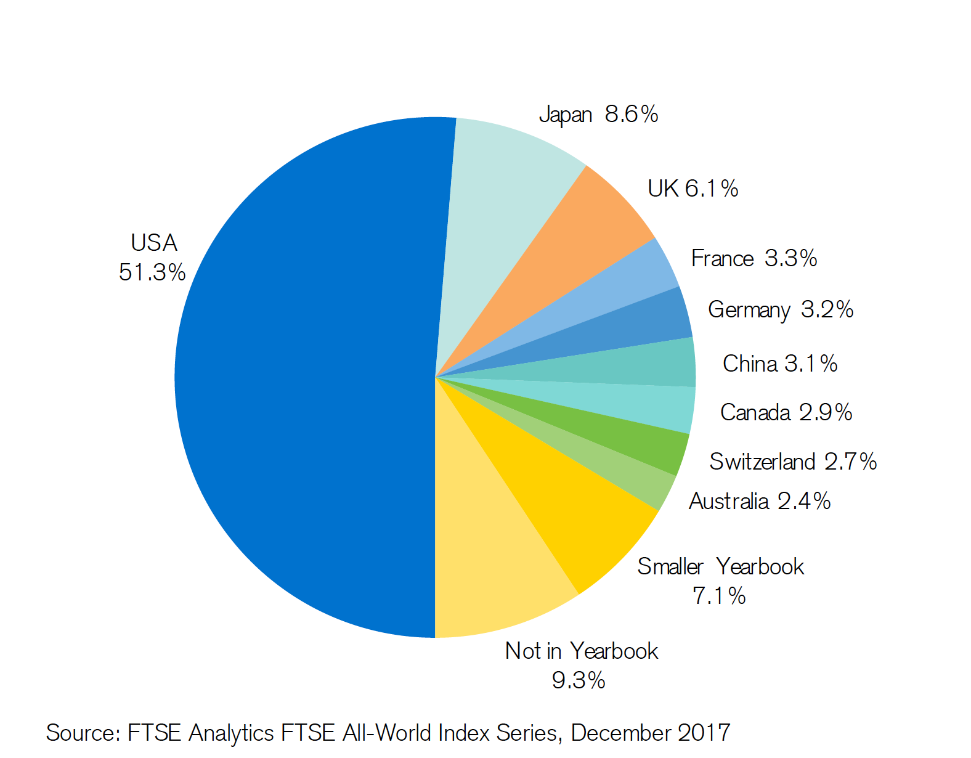
US Has Half of Current Global Debt

Slide 10
US 4.4% of World Population = 51.3% Debt

Slide 11

US Safeguarded Against Recession With 33.4% of World Wealth

Slide 12
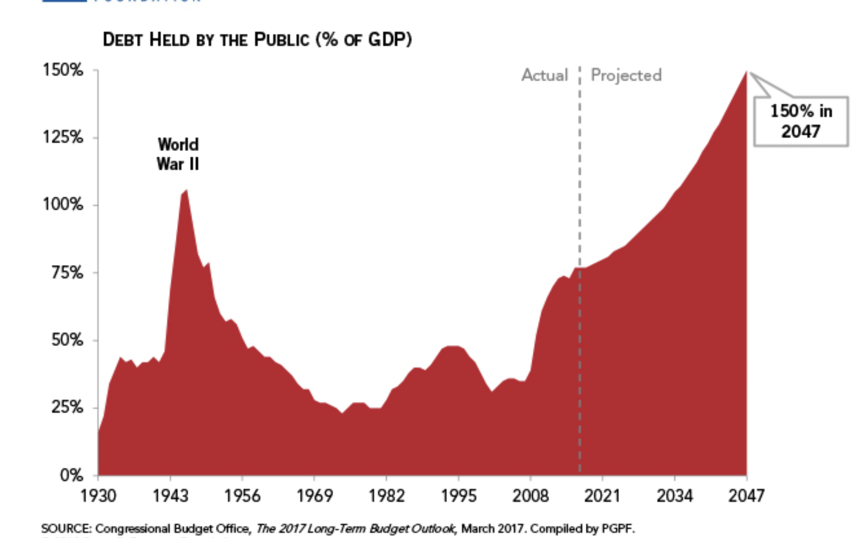
Meanwhile US Debt Rise Increases the Risks of a Recession

Slide 13
Current Increases in Risks: Over $20 Trillion
Government Deficit⬆︎
Trade Deficit
Social Security and Medicare
Healthcare Costs
Population is Aging
Return on Capital Declining

Slide 14
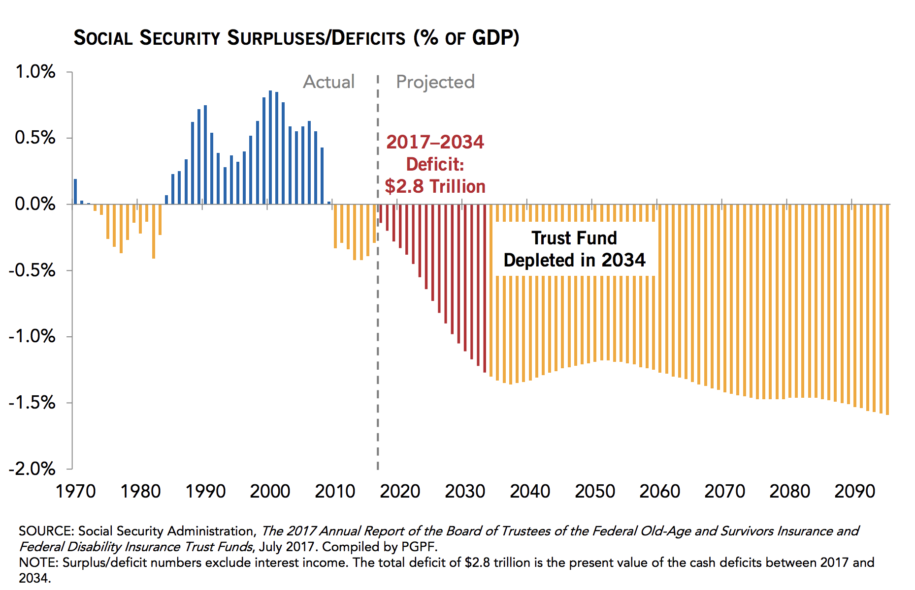
Example of Largest Risk: Social Security Deficit About $6 Trillion

Slide 15
What to Do:
Reduce Your Risks

